Slide 1
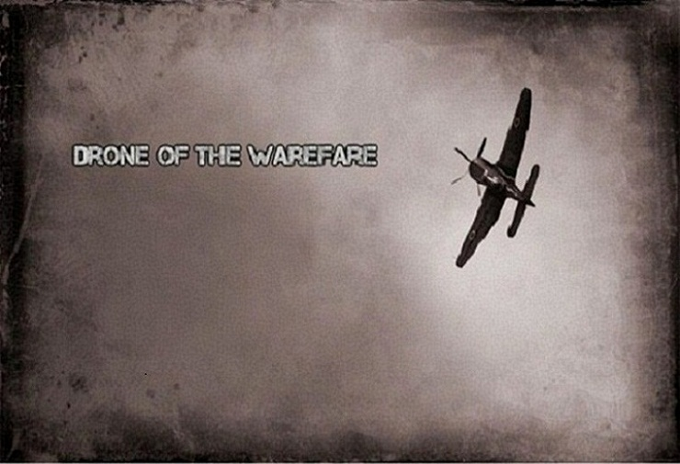

Slide 2

CMPE 202 – Fall 2014
Drone of the Warfare
By
Team 27
Gaurav Buche Swapnil Joshi
Spurthy Sambidi
Vaibhav Tupe Viresh Jivane

Slide 3
Task Board

Slide 4
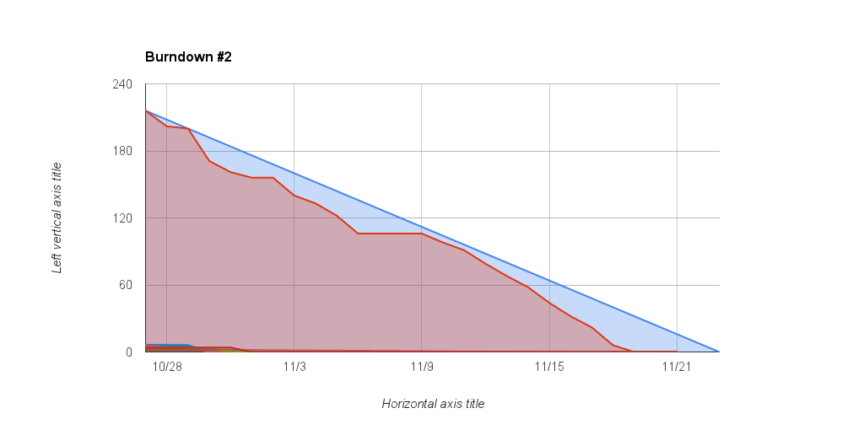
Burndown Chart

Slide 5
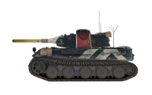
Responsibilities
Team Member : Gaurav Buche
User story creation and estimation
Designing UML Diagrams
Implementation of players life and scores
Game modules integration and Testing

Slide 6
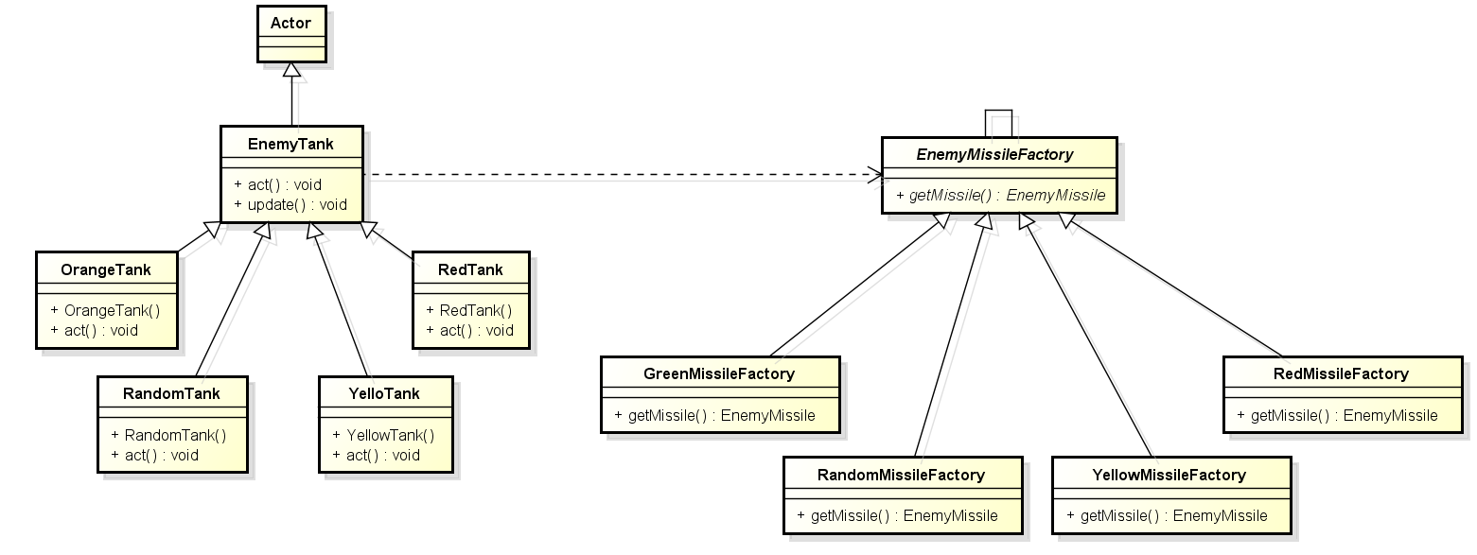
Class Diagram for Implementation of Factory Method Design Pattern – To Create Missiles

Slide 7
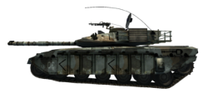
Responsibilities
Team Member : Spurthy Sambidi
User story creation and estimation
Designing UML Diagrams
Designing UI Elements and Wireframes
Integration of sounds and background effects
Game modules integration and Testing

Slide 8
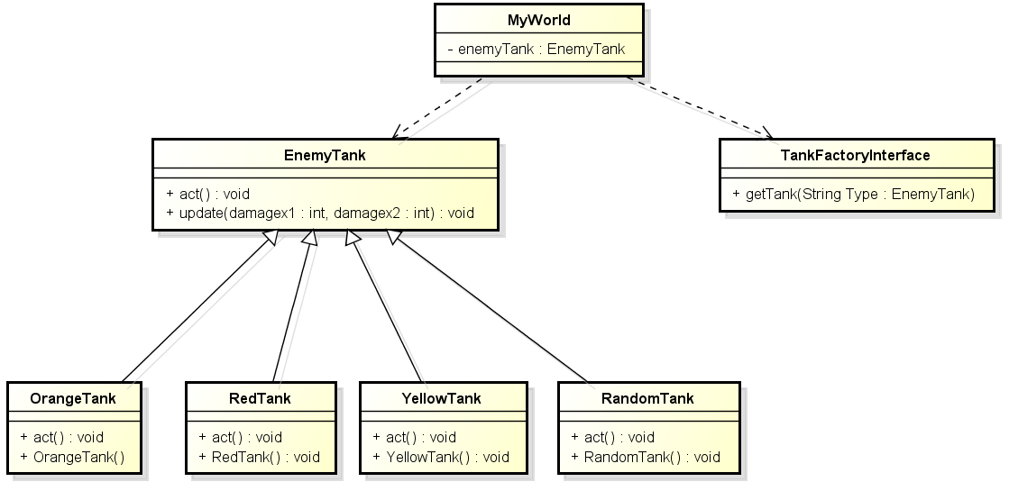
Class Diagram for Implementation of Factory Method Design Pattern – To Create Enemy Tanks on Game Screen

Slide 9
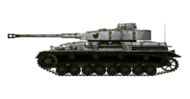
Responsibilities
Team Member : Swapnil Joshi
User story creation and estimation
Designing UML Diagrams
Implementation of GUI elements
Game modules integration and Testing

Slide 10
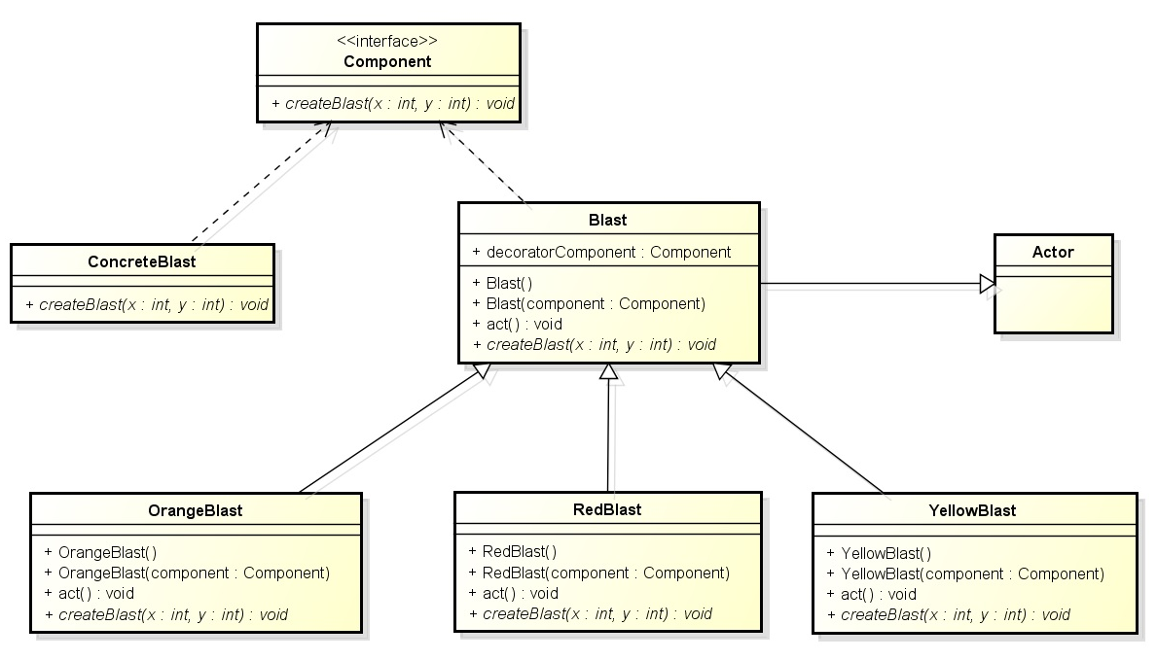
Class Diagram for Implementation of Decorator Design Pattern – To Create Blasts on Game Screen

Slide 11
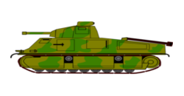
Responsibilities
Team Member : Vaibhav Tupe
User story creation and estimation
Designing UML Diagrams
Implementation of fight scenes
Game modules integration and Testing

Slide 12
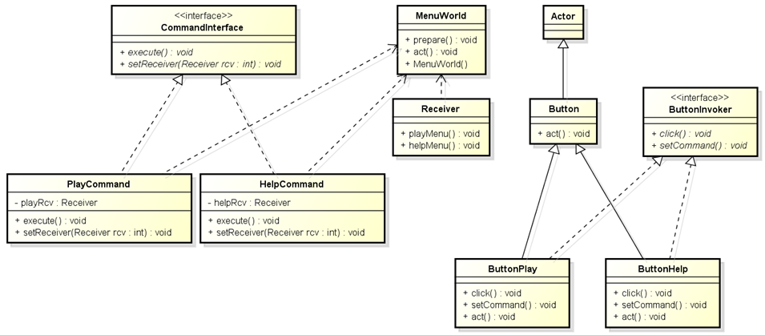
Class Diagram for Implementation of Command Design Pattern – To Display Game Startup Screen, Menu Page, Help Page and End Screen

Slide 13
Responsibilities
Team Member : Viresh Jivane
User story creation and estimation
Designing UML Diagrams
Designing UI Elements and Wireframes
Implementation of game levels
Game modules integration and Testing

Slide 14
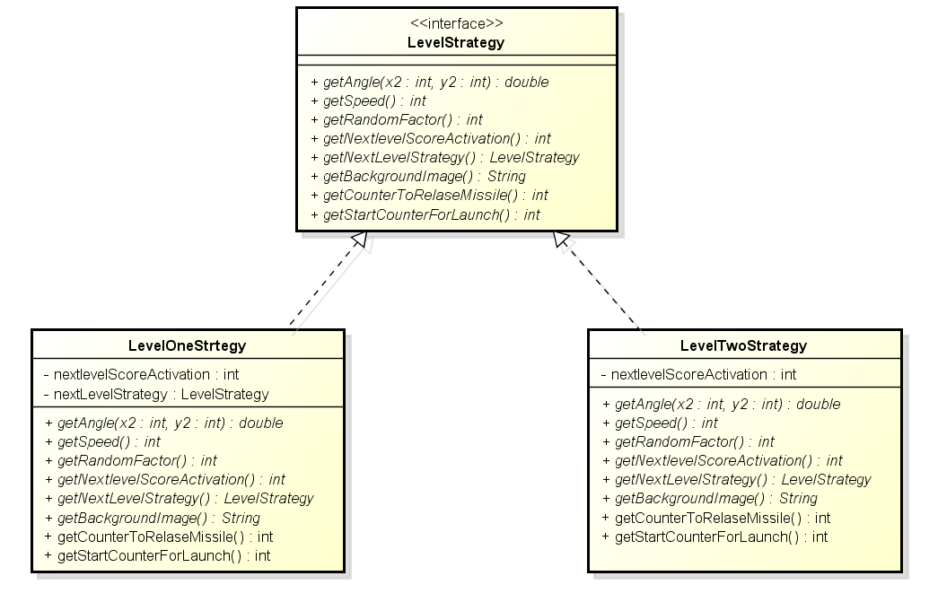
Class Diagram for Implementation of Strategy Design Pattern – Level Strategy

Slide 15
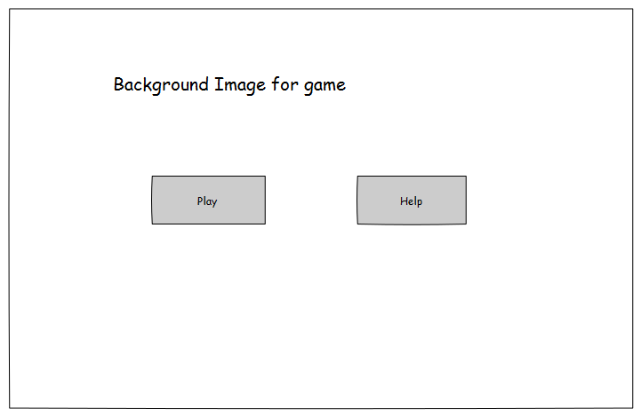
Wireframes – Game Startup

Slide 16
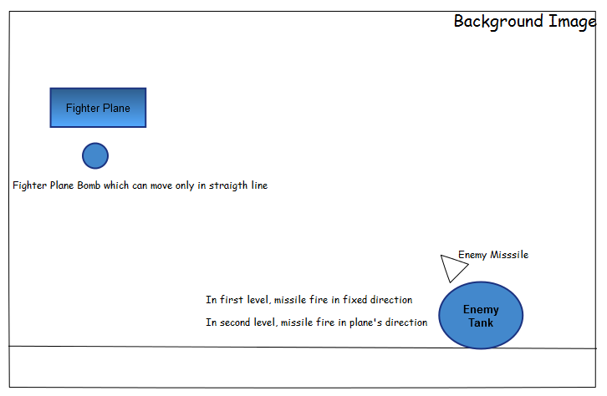
Wireframes – Game Screen

Slide 17
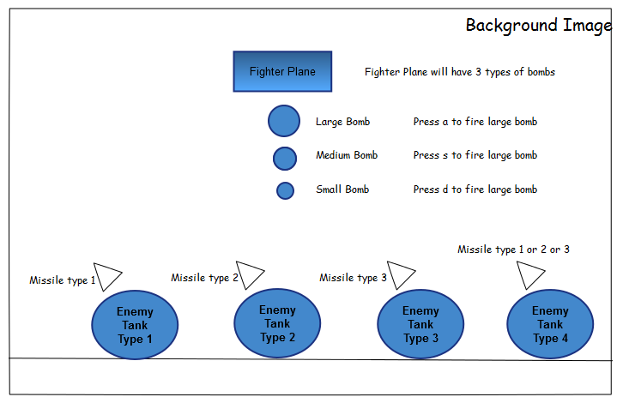
Wireframes – Game Screen

Slide 18
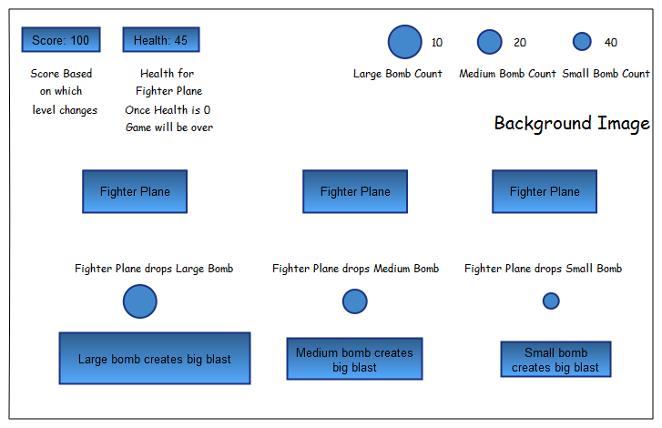
Wireframes – Game Screen

Slide 19
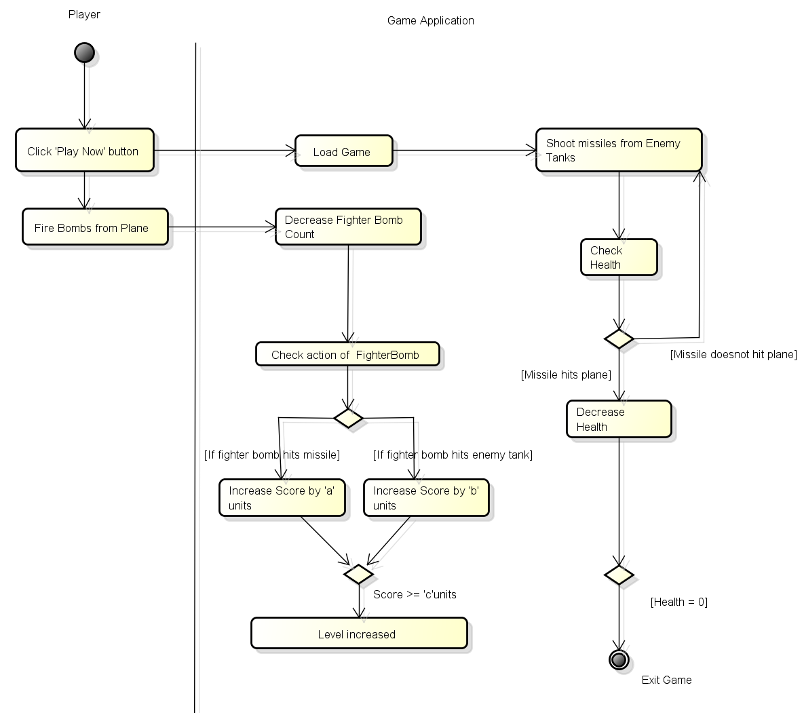
Activity Diagram

Slide 20
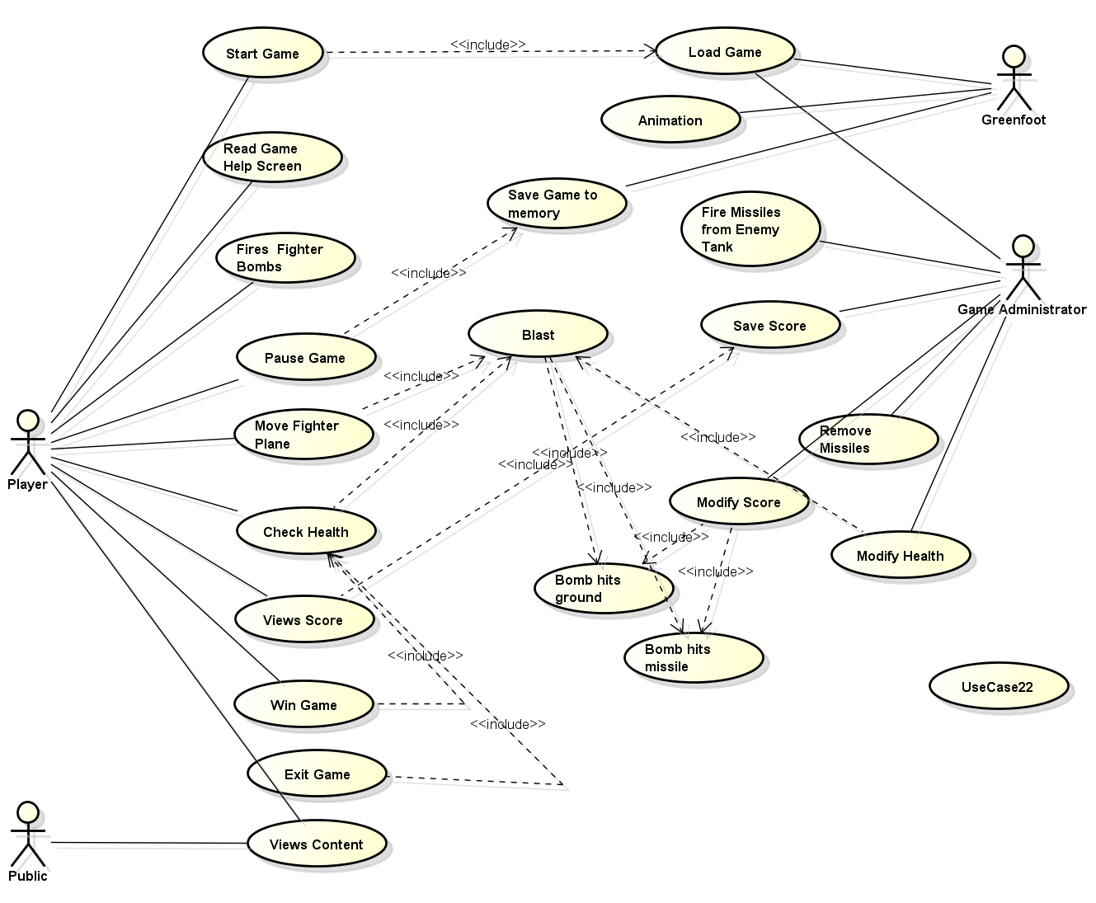

Use Case Diagram

Slide 21

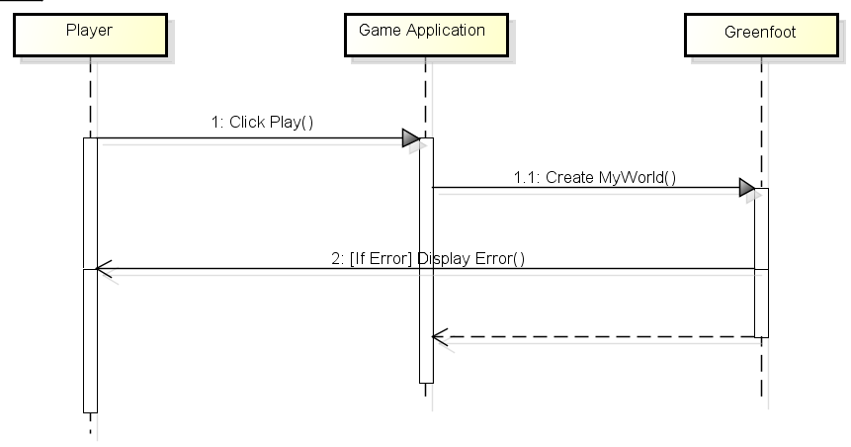
Use Case | Player clicks on 'Play' Button
Primary Actor | Player
Trigger | Play clicks on "Play" button
Pre-conditions | The player must be present on the game start-up page
Post-conditions | If success:
 | The game starts and war scene displayed to player with tanks shooting missiles at Player's drone
 | If failure:
 | Appropriate error message appears from the Greenfoot application
Use Case Specification and System Sequence Diagram

Slide 22
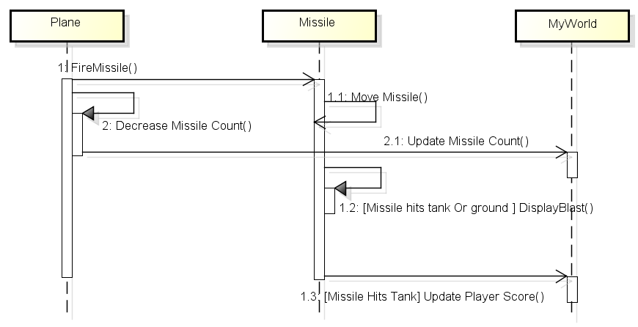
Use Case | Player shoots at tank
Primary Actor | Player
Trigger | Player press a/s/d key to fire missile at tank
Pre-conditions | Player is on game screen and plane has minimum required health and number of missiles
Post-conditions | If success:
 | If missile hits a tank, blast appears on screen with background sound and player score is increased while count of available missiles is decreased by one
 | If failure:
 | Missile misses tank and hits ground. Decreases count of total available missiles by one and no change no change in score
Use Case Specification and System Sequence Diagram

Slide 23
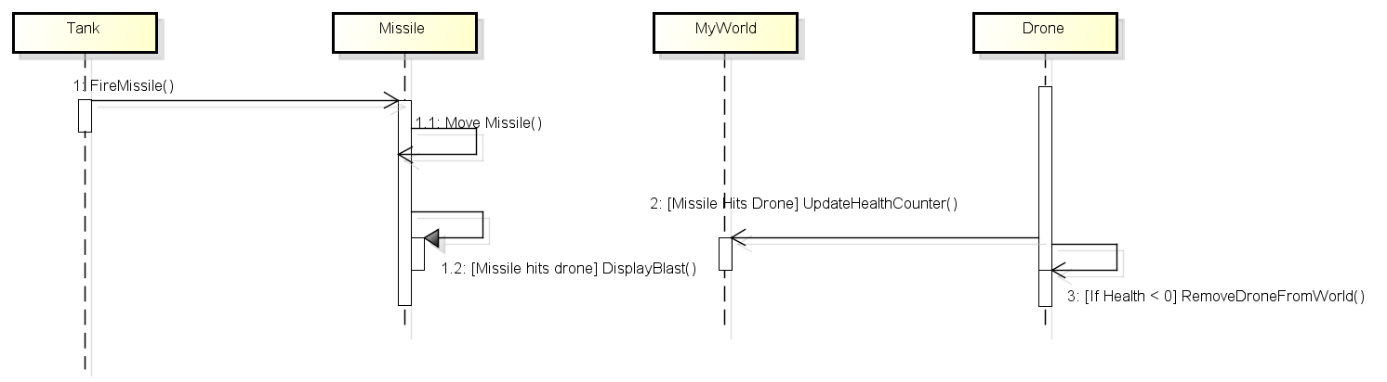
Use Case | Missile fired by tanks hits the drone
Primary Actor | Game Application
Trigger | At random events tanks in game application fire missiles towards drone
Pre-conditions | Tank and Player's Drone are present on game screen
Post-conditions | If success:
 | Missile fired by the tank hits the drone. Blast appears near drone and health of the drone is decreased based on type of missile
 | If failure:
 | Missile fired by tank misses the plan and disappears at the ends of screen. No change in drone health
Use Case Specification and System Sequence Diagram

Slide 24
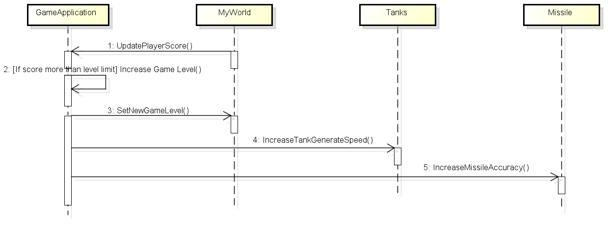
Use Case | Game Level Change
Primary Actor | Game Application
Trigger | Level change when player score reach max count of current level
Pre-conditions | Player’s Drone is present on game screen and has enough health
Post-conditions | If success:
 | Level of game will be changed from easy to complex
 | If failure:
 | Player remains in same game level
Use Case Specification and System Sequence Diagram

Slide 25
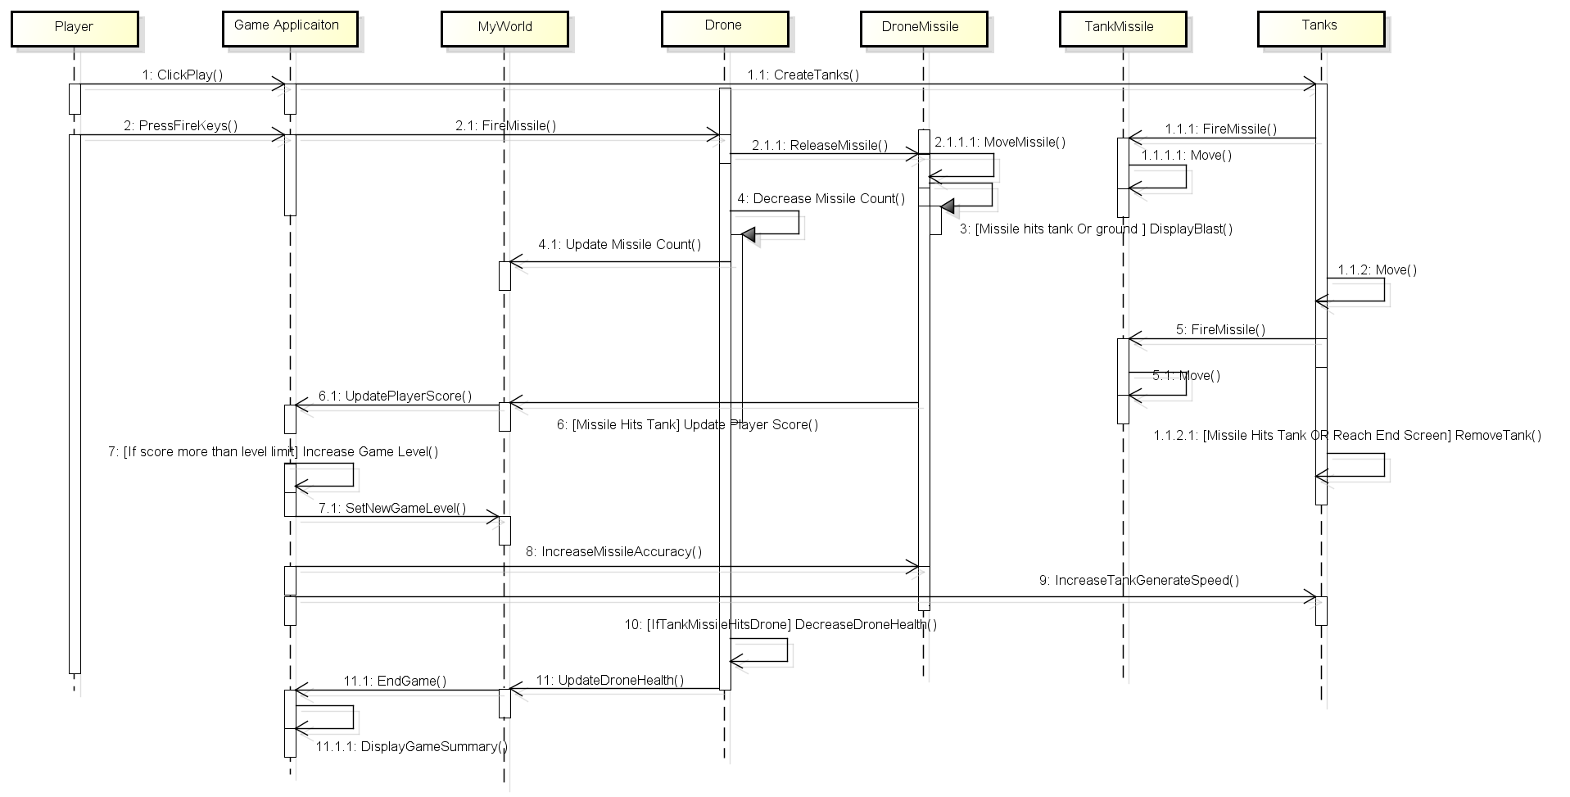
Consolidated System Sequence Diagram

Slide 26
Thanks ☺

